Slide 1
COMP6210 – BIG DATA – S1 2024
ASSIGNMENT 2 – JTP GROUP
June 2024

Slide 2

Agenda layout
Introduction
Task 1
Task 2
Report
Conclusion

Slide 3
Introduction
This group assignment focuses on implementing and analysing R-tree based algorithms for spatial data management, involving tasks such as Nearest Neighbour Search and Skyline Search.
The assignment is divided into individual tasks, each handled by a group member:
Task 1 involves finding the nearest facility using Sequential Scan, Best First (BF), and BF with Divide-and-Conquer algorithms.
Task 2 focuses on identifying optimal homes based on cost and size using Sequential Scan, Branch and Bound Skyline (BBS), and BBS with Divide-and-Conquer algorithms.
Task 3 includes a comprehensive project report presenting the in-depth description of the primary functions which are used in Task 1 and Task 2 and a clear specification of operating system environment, location of input files, any essential input parameters. The report also provides the detailed explanations of the BF algorithm-based nearest neighbour search and BBS-based skyline search, including diagrams and step-by-step analysis.
Group Task includes a group presentation providing a comprehensive overview of In-depth analysis and understanding and outputs of Task 1 and Task 2, and the discussion of the case studies from the project report.

Slide 4



Task 1

Slide 5
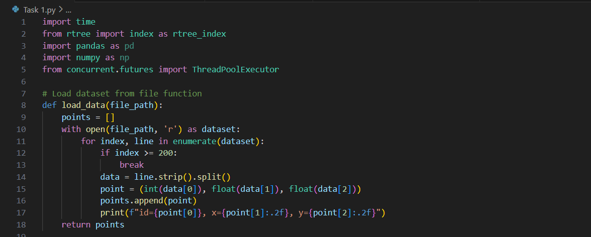
Task 1
Nearest Neighbor Search - Sequential scan (1/3)

Slide 6
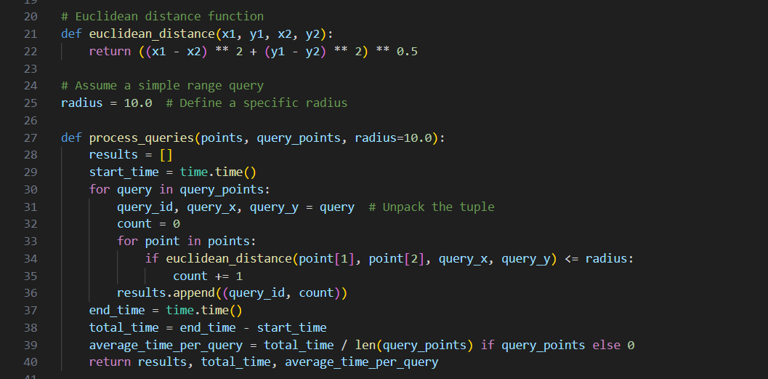
Task 1
Nearest Neighbor Search - Sequential scan (2/3)

Slide 7
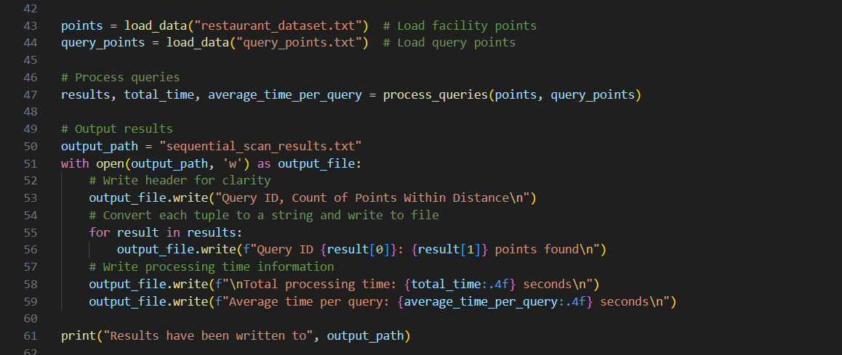
Task 1
Nearest Neighbor Search - Sequential scan (3/3)

Slide 8
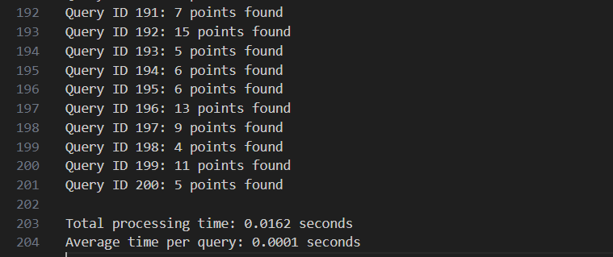
Task 1
Nearest Neighbor Search - Sequential scan output
Total processing time for all queries is 0.0162 seconds and average time to process one query is 0.0001.
Each query ID corresponds to the number of points found within a specified radius (10.0 units) around the query point.
The total and average processing times indicate that the script is highly efficient for the given dataset size and query count.

Slide 9
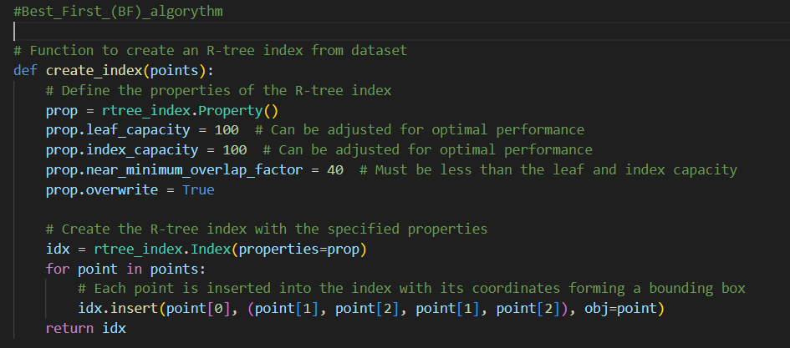
Task 1
Nearest Neighbor Search - Best First(1/3)

Slide 10
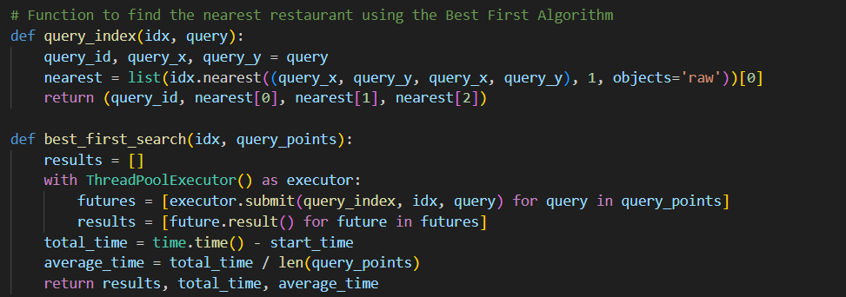
Task 1
Nearest Neighbor Search - Best First(2/3)

Slide 11
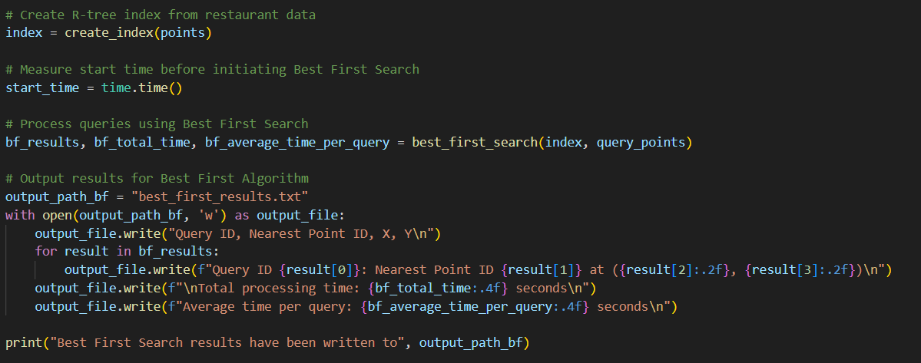
Task 1
Nearest Neighbor Search - Best First(3/3)

Slide 12
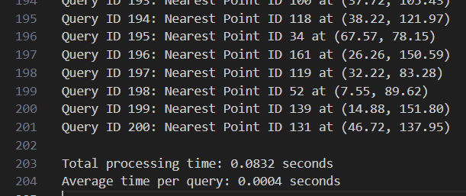
Task 1
Nearest Neighbor Search - Best First output
Total Processing Time: 0.0832 seconds for processing all queries.
Average Time per Query: 0.0004 seconds.
The processing times are slightly higher compared to the previous method, likely due to the complexity of finding the exact nearest point rather than counting points within a radius.
Each query ID is matched with its nearest point ID, along with the coordinates of that nearest point.

Slide 13
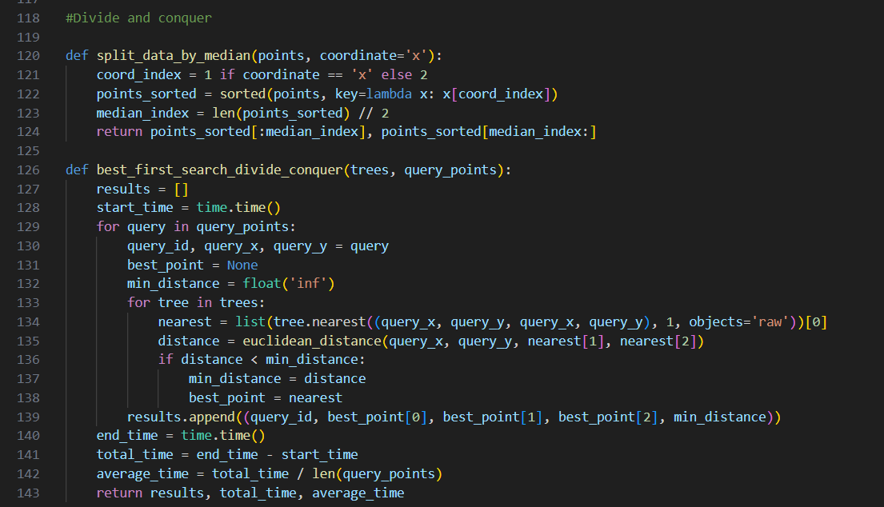
Task 1
Nearest Neighbor Search - Divide and Conquer (1/2)

Slide 14
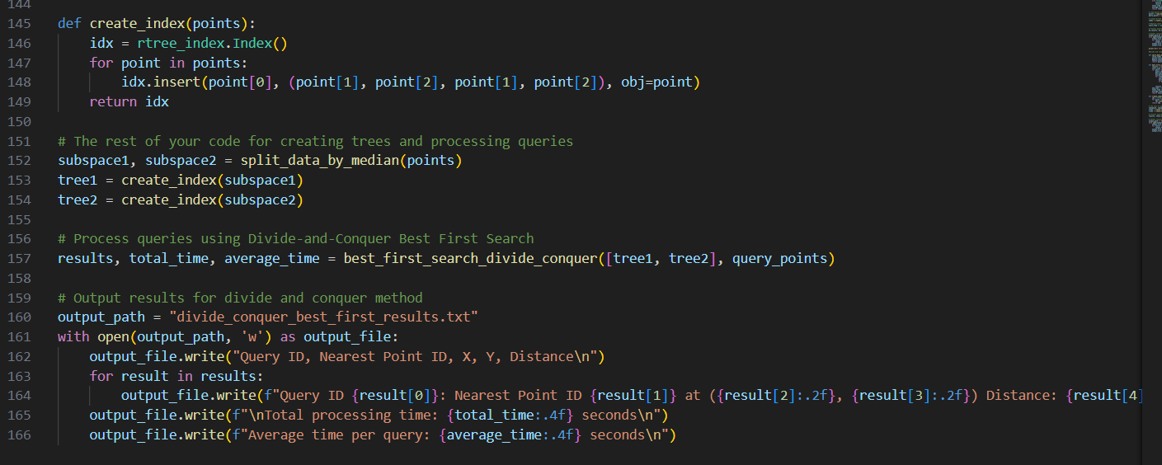
Task 1
Nearest Neighbor Search - Divide and Conquer (2/2)

Slide 15
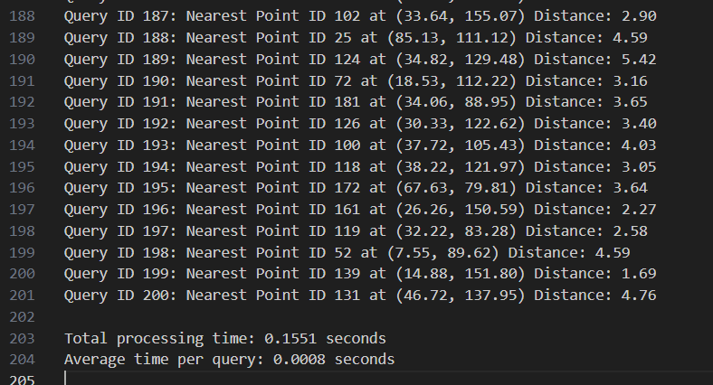
Task 1
Nearest Neighbor Search - Divide and Conquer output
Each query ID is matched with its nearest point ID, along with the coordinates of that nearest point and the distance to it.
Total Processing Time: 0.1551 seconds for processing all queries.
Average Time per Query: 0.0008 seconds.
The total and average processing times are slightly higher compared to simpler search algorithms due to the additional complexity introduced by the divide and conquer approach.

Slide 16
Task 2

Slide 17
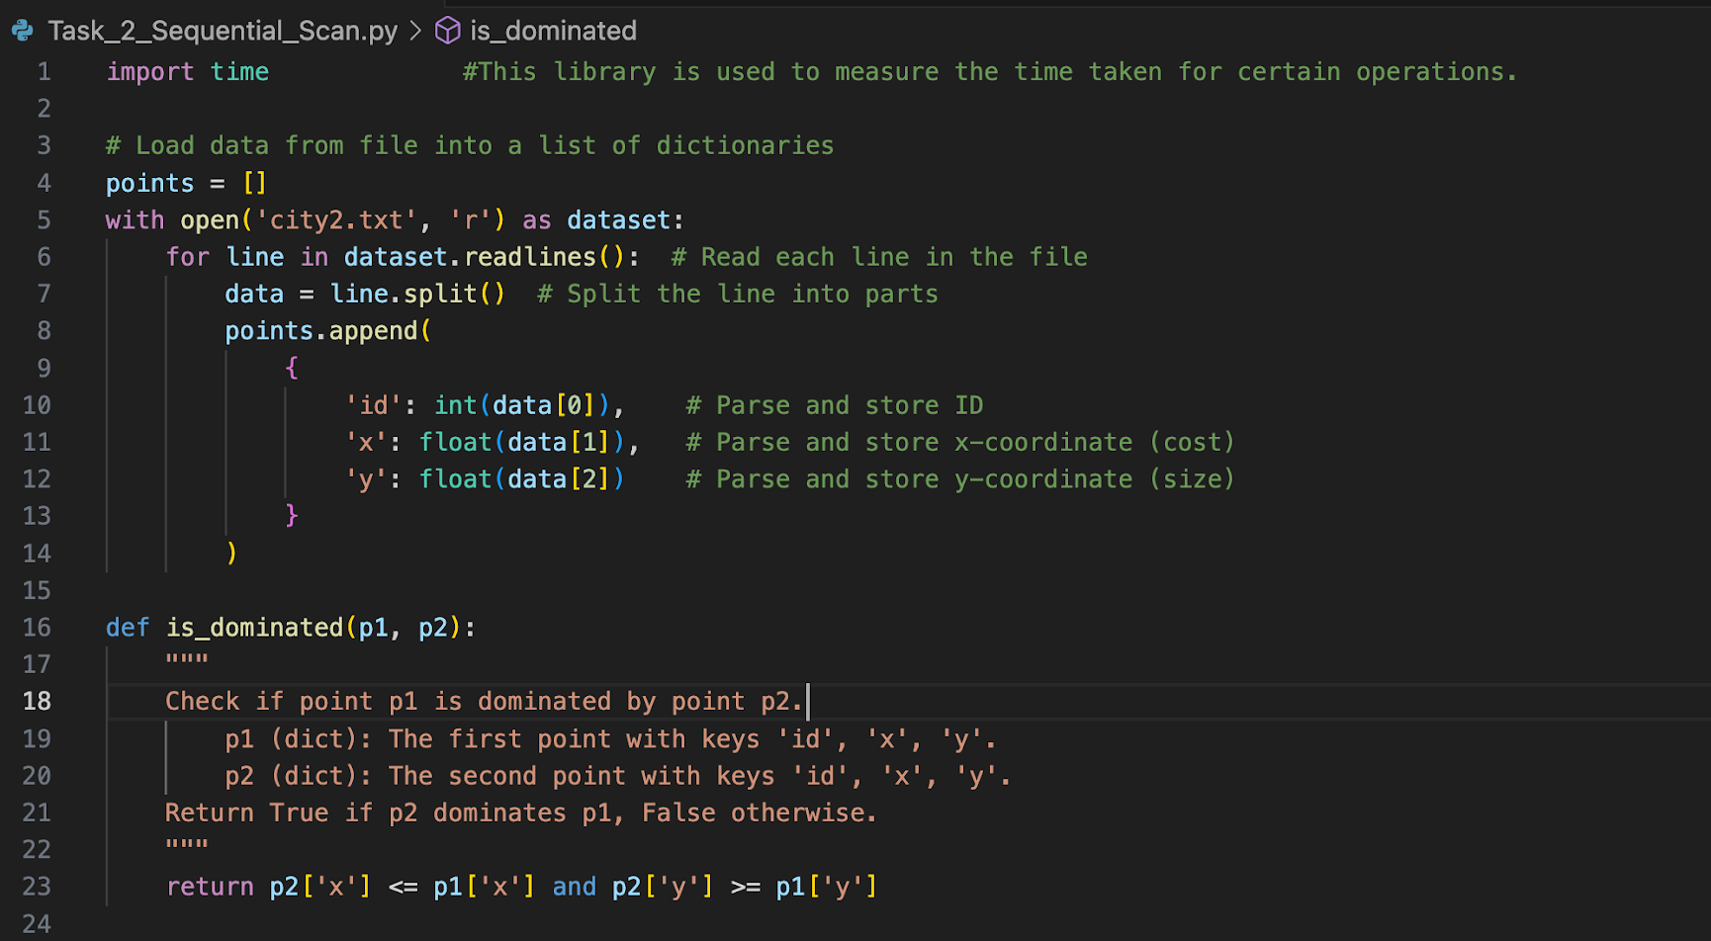
Task 2
SKYLINE SEARCH – SEQUENTIAL SCAN (1/5)

Slide 18
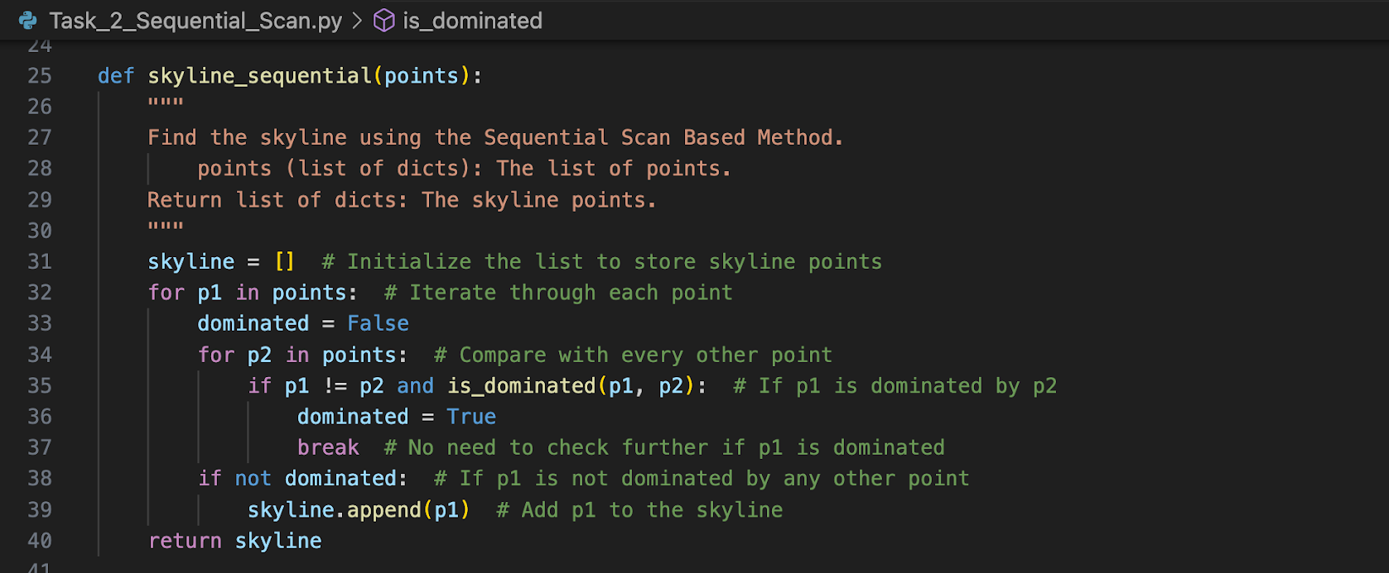
Task 2
SKYLINE SEARCH – SEQUENTIAL SCAN (2/5)

Slide 19
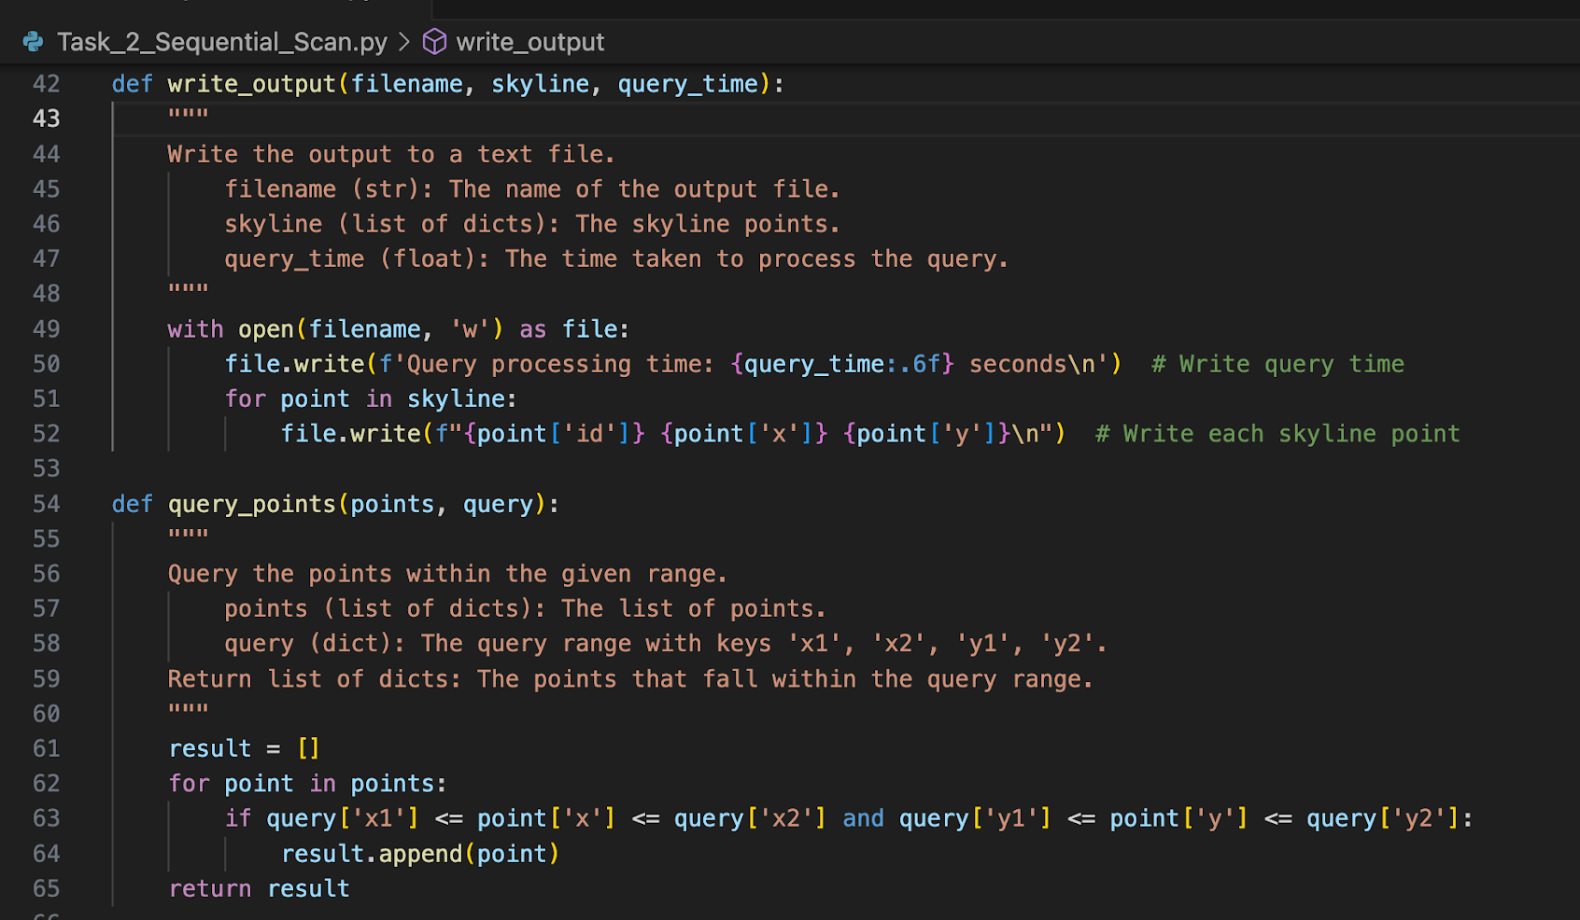
Task 2
SKYLINE SEARCH – SEQUENTIAL SCAN (3/5)

Slide 20
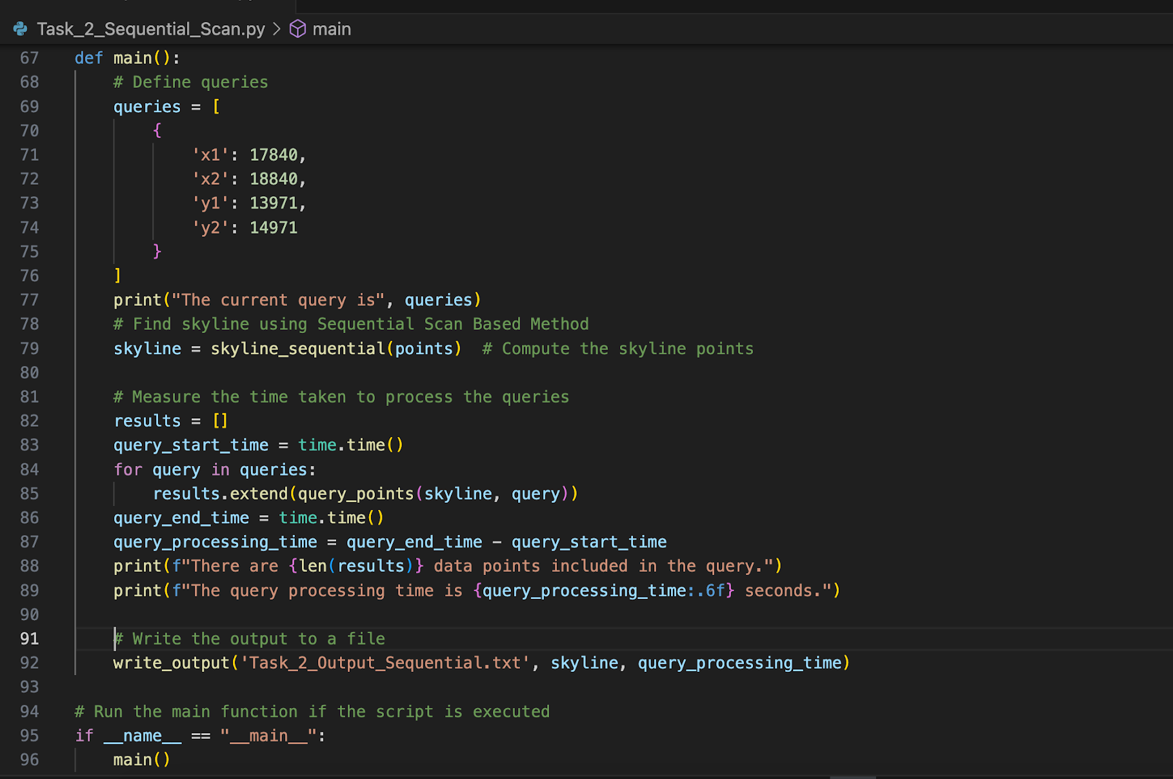
Task 2
SKYLINE SEARCH – SEQUENTIAL SCAN (4/5)

Slide 21
Task 2
SKYLINE SEARCH – SEQUENTIAL SCAN – OUTPUT (5/5)
Query processing time: 0.000014 seconds
30247 338.34 800.0
60245 300.27 794.59
68846 302.96 799.87
72081 312.74 799.99
74464 300.0 790.74
169722 300.66 797.96
241342 300.35 796.02
263791 301.12 799.7
280895 300.2 793.77
Query Processing Time is 0.000014 seconds. The query processing time indicates that the Sequential Scan method is efficient in processing the query. The very short processing time suggests that the algorithm is well-optimized for this specific dataset.
The output lists the skyline points identified using the Sequential Scan method. Each line consists of three values: ID, cost (x-value), and size (y-value). These points represent homes that provide the best balance of cost and size within the dataset.

Slide 22
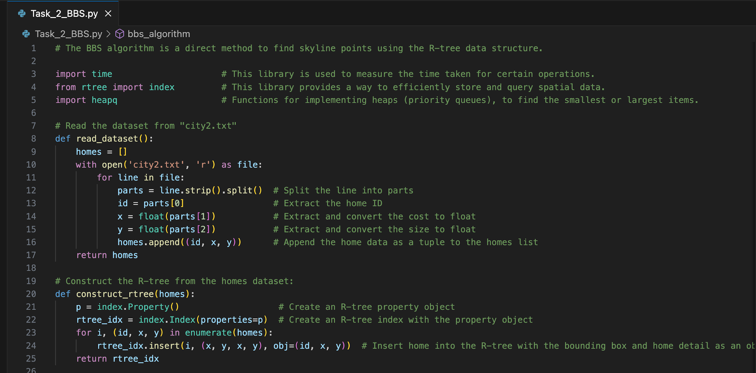
Task 2
SKYLINE SEARCH – BRANCH AND BOUND SKYLINE (BBS) ALGORITHM (1/4)

Slide 23
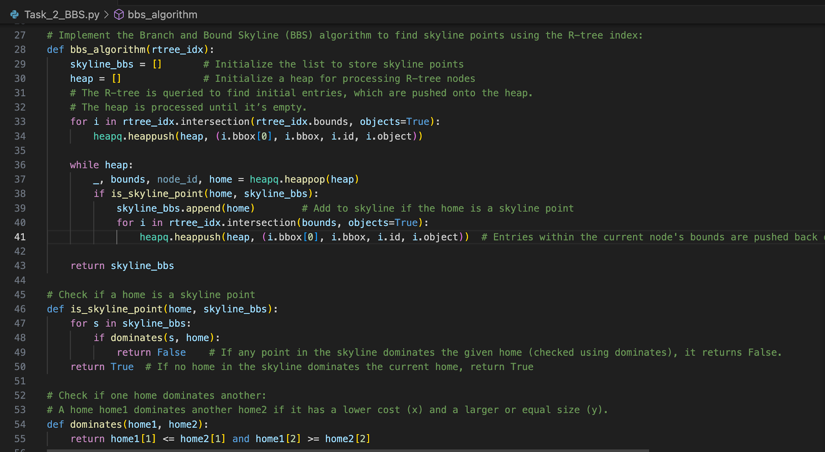
Task 2
SKYLINE SEARCH – BRANCH AND BOUND SKYLINE (BBS) ALGORITHM (2/4)

Slide 24
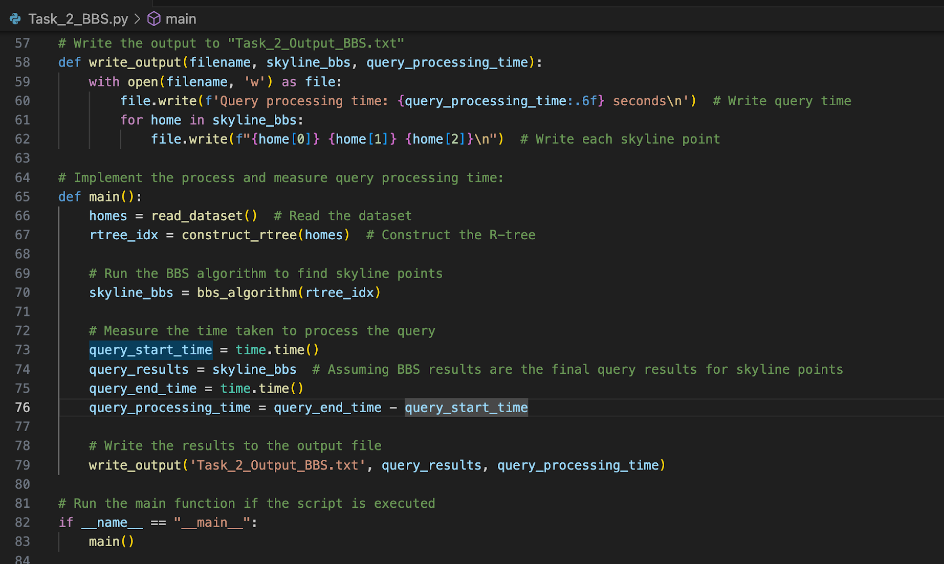
Task 2
SKYLINE SEARCH – BRANCH AND BOUND SKYLINE (BBS) ALGORITHM (3/4)

Slide 25
Task 2
SKYLINE SEARCH – BRANCH AND BOUND SKYLINE (BBS) ALGORITHM – OUTPUT (4/4)
Query processing time: 0.000001 seconds
74464 300.0 790.74
280895 300.2 793.77
60245 300.27 794.59
241342 300.35 796.02
169722 300.66 797.96
263791 301.12 799.7
68846 302.96 799.87
72081 312.74 799.99
30247 338.34 800.0
Query Processing Time is 0.000001 seconds. The very short processing time highlights the efficiency of the BBS algorithm when combined with the R-tree data structure. This function allows us to explore all relevant parts of the tree to find skyline points without scanning every point in the dataset, making it much faster than a simple Sequential Scan.
The output lists the skyline points identified using the BBS algorithm. Each line consists of three values: ID, cost (x-value), and size (y-value).
These points represent homes that provide the best balance of cost and size within the dataset.

Slide 26
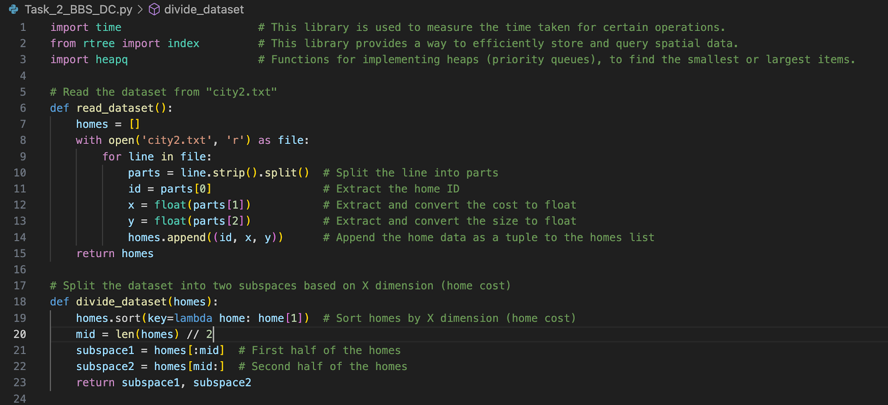
Task 2
SKYLINE SEARCH – BBS WITH DIVIDE-AND-CONQUER (1/5)

Slide 27
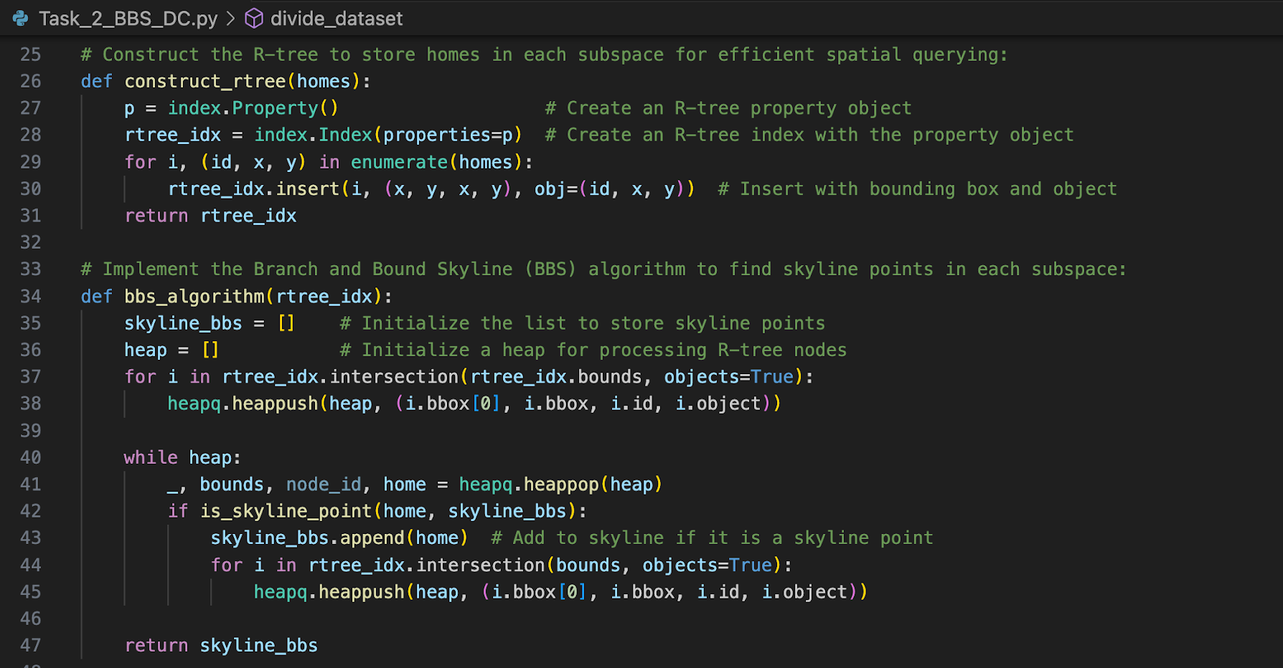
Task 2
SKYLINE SEARCH – BBS WITH DIVIDE-AND-CONQUER (2/5)

Slide 28
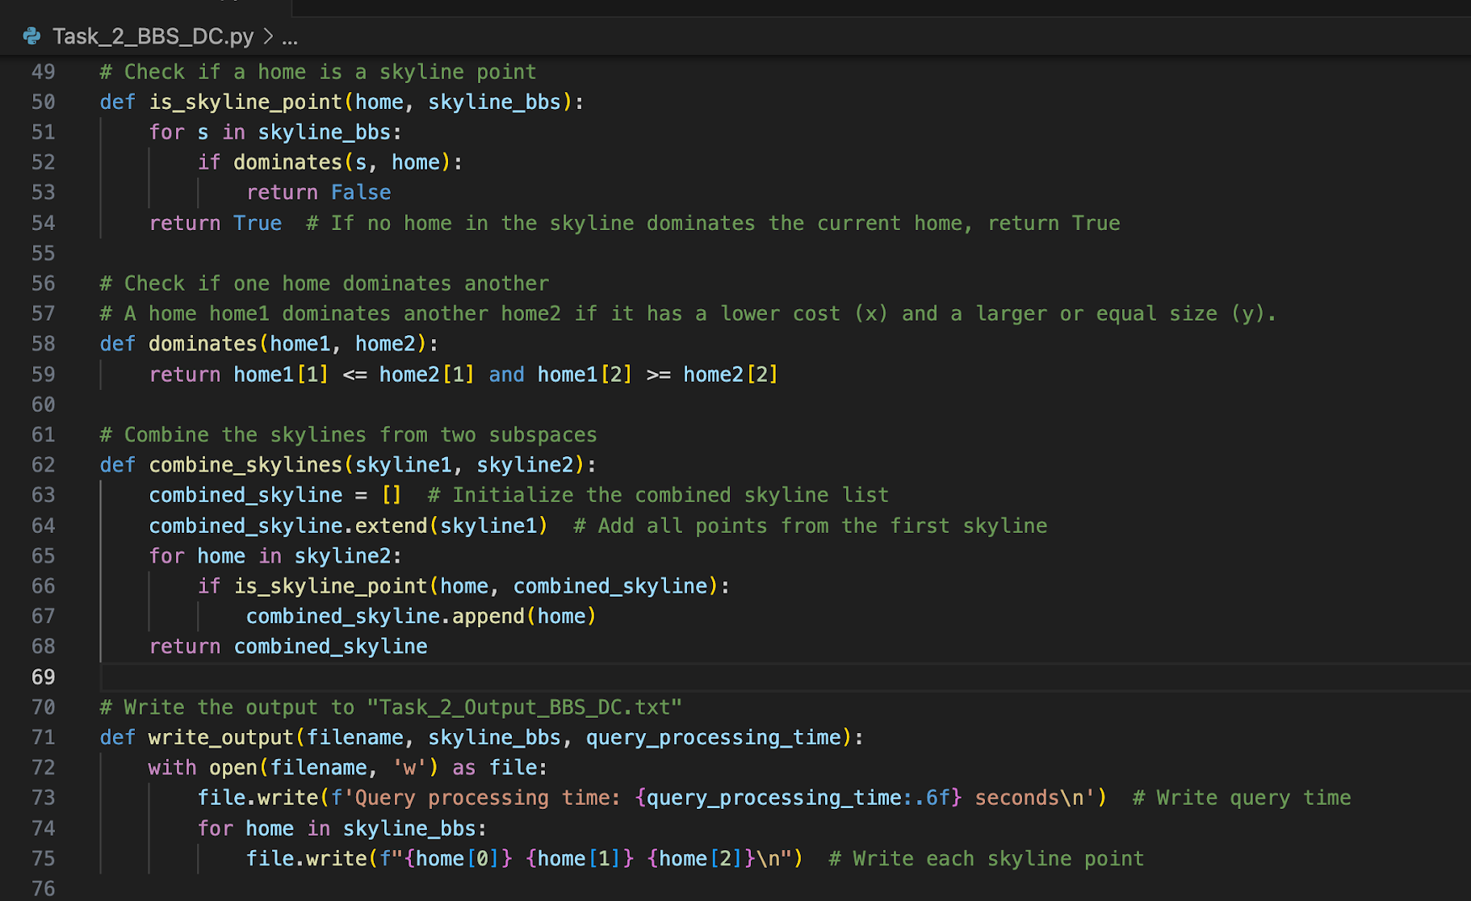
Task 2
SKYLINE SEARCH – BBS WITH DIVIDE-AND-CONQUER (3/5)

Slide 29
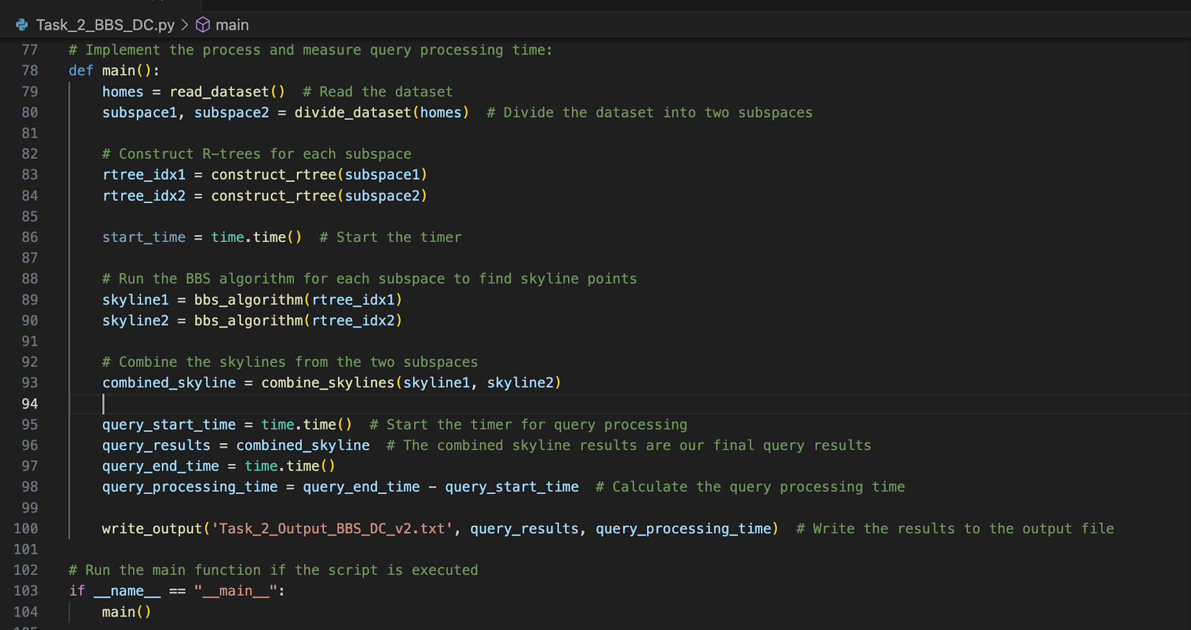
Task 2
SKYLINE SEARCH – BBS WITH DIVIDE-AND-CONQUER (4/5)

Slide 30
Task 2
SKYLINE SEARCH – BBS WITH DIVIDE-AND-CONQUER – OUTPUT (5/5)
Query processing time: 0.000000 seconds
74464 300.0 790.74
280895 300.2 793.77
60245 300.27 794.59
241342 300.35 796.02
169722 300.66 797.96
263791 301.12 799.7
68846 302.96 799.87
72081 312.74 799.99
30247 338.34 800.0
Query Processing Time: 0.000000 seconds. This result indicates an extremely efficient processing time for the BBS with Divide-and-Conquer algorithm.
We observe that the BBS with Divide-and-Conquer algorithm has highest efficiency compared to the standard BBS algorithm and Sequential Scan method thanks to the following reasons:
The dataset is divided into subspaces reduces the number of points each subspace algorithm needs to handle.
The ability to process subspaces independently allows for parallel execution, leading to faster overall processing time.
Smaller R-trees are faster to query, leading to quicker dominance checks.
Fewer points in each subspace mean fewer comparisons, and combining only skyline points reduces the final comparison count further.

Slide 31
Task 3

Slide 32
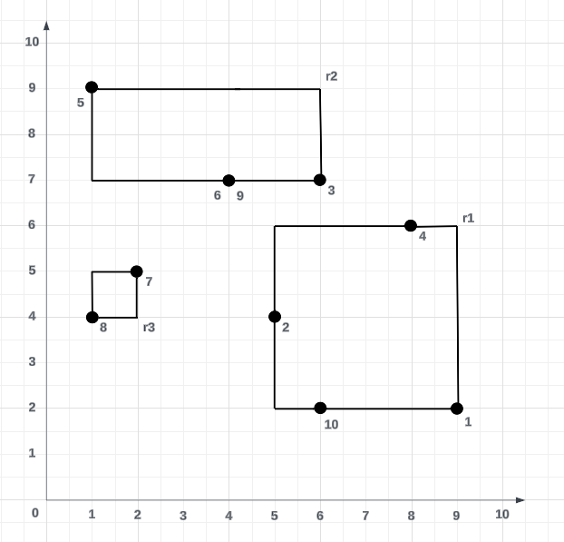
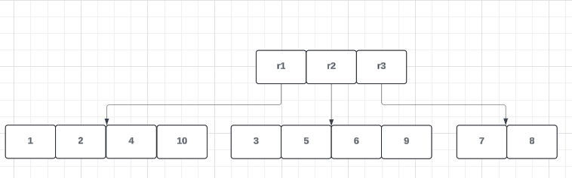
Task 3
Constructing the R-Tree for the BF Algorithm
An R-Tree is a data structure that is used for indexing spatial data
Constructing the R-Tree begins with identifying what ‘B’ is
When the maximum number of entries exceeds ‘B’, a node split occurs to prevent overflowing
R-Trees are split according to how big the new Minimum Bounding Rectangles are

Slide 33
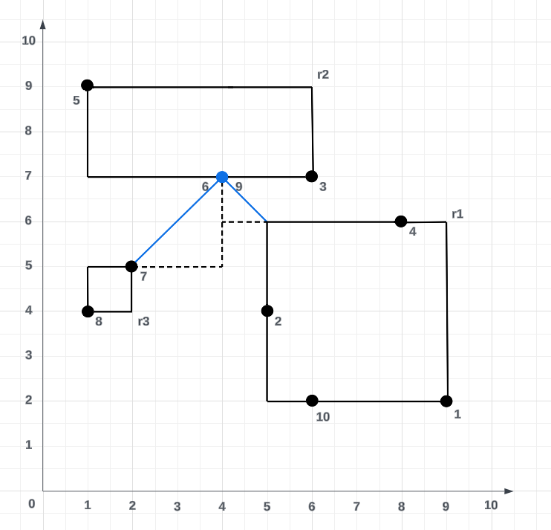
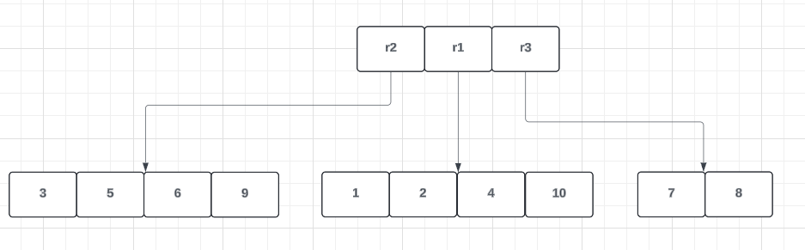
Task 3
Using the BF Algorithm to find the query result
Best-First Algorithm involves finding the minimum distance of the query point to the nearest point in the dataset
Utilises a sorting tree to store the distances between query point and each node

Slide 34
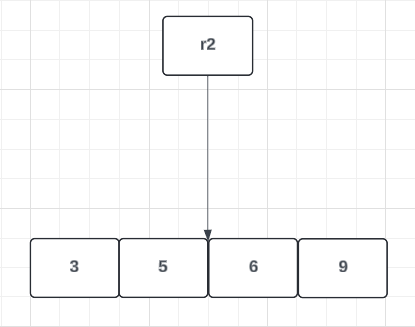
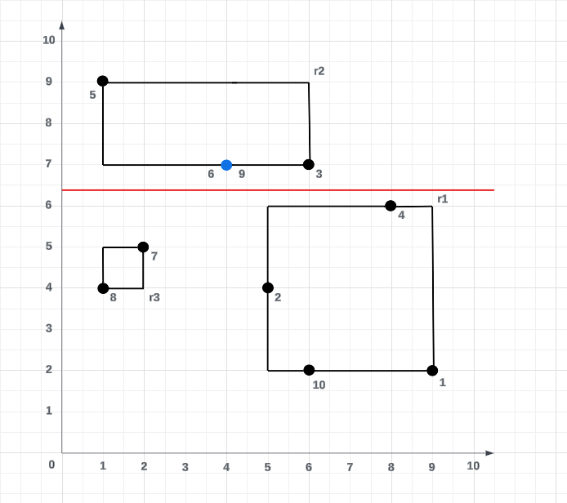
Task 3
Applying the Divide-and-Conquer idea to the BF Algorithm
Divide-and-Conquer consists of partitioning the dataset into segments and analysing each segment separately
In this case, query point sits at the same spot as Point 6 and point 9

Slide 35
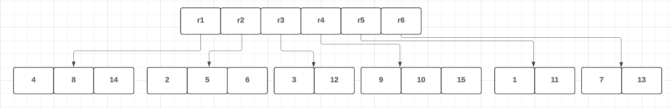
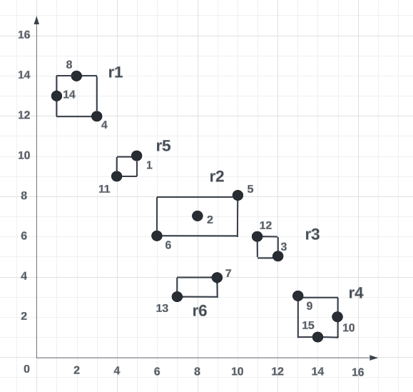
Task 3
Constructing the R-Tree for BBS Algorithm
The R-Tree concept remains the same, except with more data points
Maximum amount of points in a node set to 3 (B = 3)
Goal of minimising perimeter area for MBR remains the same

Slide 36
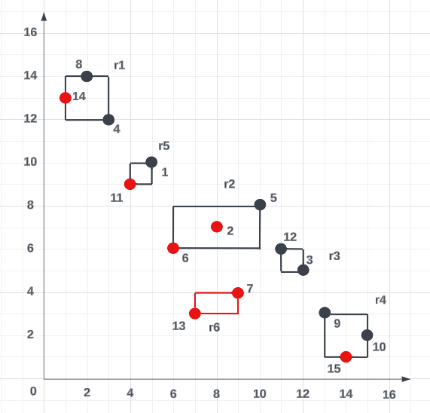
Task 3
Executing the BBS Algorithm
Branch-and-Bound Skyline (BBS) algorithm is used to identify skyline points
Checks nodes for points that aren’t dominated
Two points of criteria to determine whether a point is dominated or not
If all points in a node are dominated, the node is considered “pruned”
Node that is closest to the origin is checked first

Slide 37
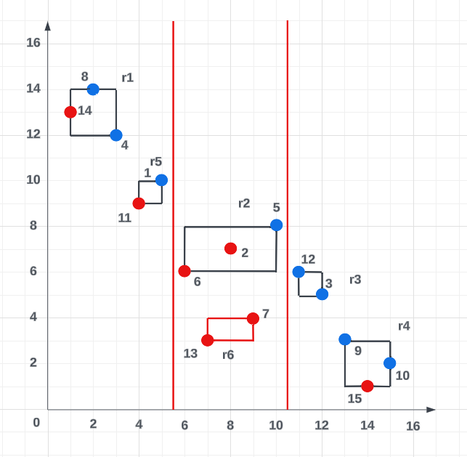
Task 3
How the Divide-and-Conquer idea is applied to the BBS Algorithm
Divide-and-Conquer idea involves breaking down a problem into smaller components and solving it
This can be utilised with the BBS algorithm by splitting the dataset into segments and solving for local skyline points
Afterwards, local skyline points are merged and then are checked to identify global skyline points
Concept of ‘pruning’ nodes remains the same

Slide 38



JTG Group Member
Name | Profile photo | Student ID | Email: | Assigned Task
Cam Tu (Jenna) Pham – Group Coordinator |  | 46864598 | camtu.pham @students.mq.edu.au | Group Coordinator - in charge of reviewing and submitting project documents Task 2 (Source Code and Output txt file) Presentation on Task 2
Thi Minh Thi Tran |  | 45773157 | thi-minh-thi.tran @students.mq.edu.au | Task 1 (Source Code and Output txt file) Presentation on Group assignment Introduction and Task 1 Combine the video records to a complete presentation
Govardhan (Gov) Bharadwaj |  | 46980164 | govardhan.Bharadwaj @students.mq.edu.au | Task 3 (Project Report) Presentation on Task 3 and Group assignment Conclusion

Slide 39
Conclusion
Our group successfully implemented and analyzed R-tree based algorithms for spatial data management, focusing on Nearest Neighbour and Skyline searches.
Task 1 demonstrated the efficiency of Sequential Scan, Best First, and Divide-and-Conquer algorithms for nearest facility searches.
Task 2 highlighted the effectiveness of Skyline searches using Sequential Scan, BBS, and BBS with Divide-and-Conquer, showcasing optimized performance for identifying optimal homes based on cost and size.
The comprehensive report and presentation provide in-depth analysis, performance metrics, and case studies, underscoring the significance of these algorithms in managing large spatial datasets efficiently.
This project has significantly enhanced our understanding and expertise in big data applications.

